Slide 2
Virtual Reality Development

Slide 3




Jonathan Van Beneden
@Osuryn
Jonathan.VanBeneden@Realdolmen.com
https://github.com/Osuryn

Slide 4
Before we get started
Ask Questions
Get your “Golden Ticket”

Slide 5
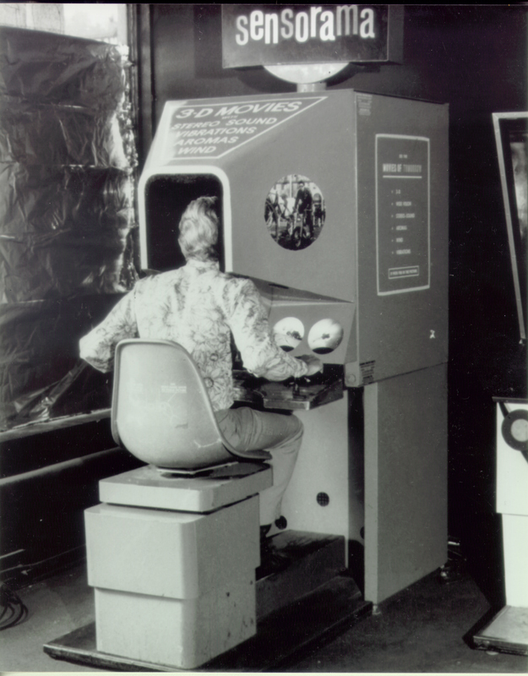
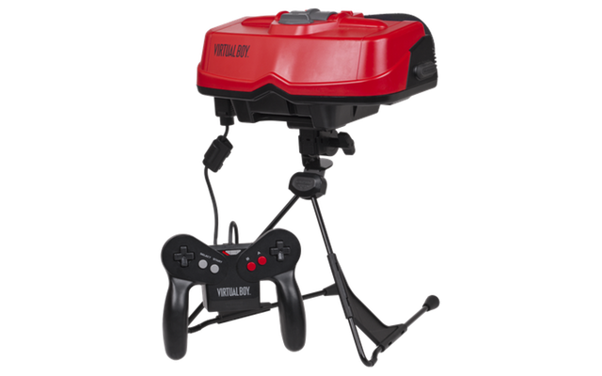

Slide 6
Virtual Reality, The future starts now

Slide 7
Agenda
Virtual Reality
What is Virtual Reality
VR vs. AR vs. MR
Oculus Rift vs. HTC Vive
Game Engine
What is Unity3D
Getting started with Unity3D
Demo
Q&A

Slide 8
Virtual Reality
What is Virtual Reality
VR vs. AR vs. MR
Oculus Rift vs. HTC Vive

Slide 9
What is Virtual Reality
“An artificial environment that is created with software and presented to the user in such a way that the user suspends belief and accepts it as a real environment.”

Slide 10
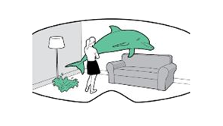
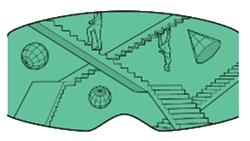

VR vs. AR vs. MR
Virtual Reality
Oculus Rift
HTC Vive
Gear VR
Google Cardboard
Augmented Reality
Mobile apps
Internet of Things
Mixed Reality
Microsoft Hololens

Slide 11






Passive Experience
Simulator games
Active Experience
Puzzle games
Min Specs.
NVIDIA GTX 970
Intel I5 gen 4+
8 GB RAM
HDMI 1.3
2 * USB 3.0
Min Specs.
NVIDIA GTX 970
Intel I5 gen 4+
4 GB RAM
HDMI 1.4
1 * USB 2.0

Slide 12
Game Engine
Unity3D
Getting Started with Unity3D

Slide 13



Unity3D
Game Engine
Payment plans
Free
Plus ($35 / month)
Pro ($125 / month)
Enterprise

Slide 14
Getting started with Unity3D
Multiplatform applications
Games can be created without a lot of code
Scripting < > Programming
.NET version 3.5 (Mono)
Asset store
Active developer community

Slide 15
Demo
Notes:
Demo:
Create Project in Unity
Create new terrain
Import standard assets
Add trees
Add Water
Import Oculus Support
Add Oculus Player Controller – rename tag to ‘player’
Show off scripting (UI Script to show a counter of items0
Bind counter to event that is broadcasted somewhere else
Add Object (Red Ball)
Create material
Make Ball Red
Add rigid body
Add collider
Add Event to ball when player runs over the ball the counter goes up
Add function that broadcasts
Find the script object
Broadcast on that object
Make empty object called world,
Add all game objects
Call broadcast on World in stead of on the script
Add collider function that check player collision
Execute the BallCaptured function
Start Demo

Slide 16
Q&A
@Osuryn
https://github.com/Osuryn
Jonathan.VanBeneden@Realdolmen.com

Slide 17
Join us! @ jobs.realdolmen.com @ stage.realdolmen.com

